Slide 1

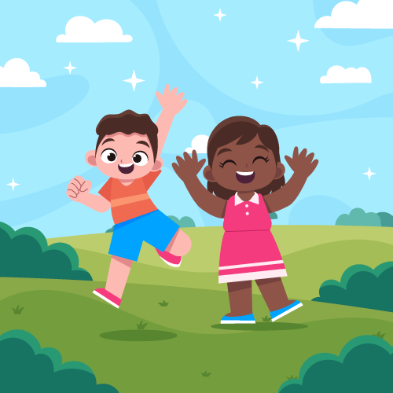


To Be An
Upstander
lausd.org/human-relations

Slide 2
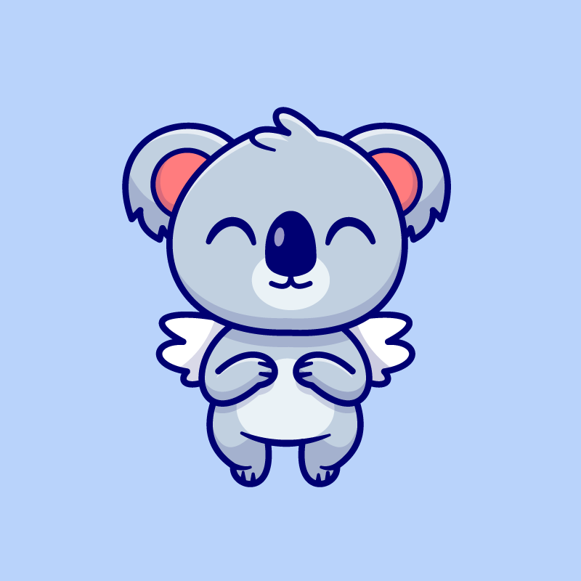
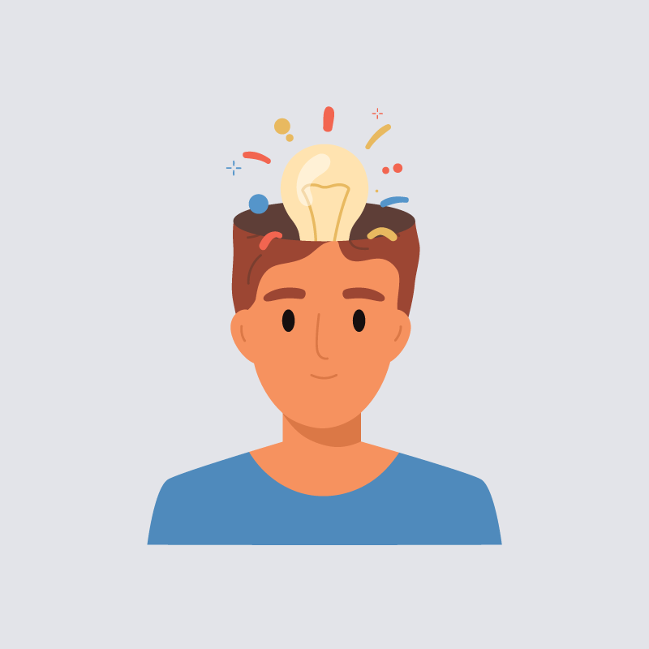
Would You Rather
Talk to animals
Hear people’s thoughts
lausd.org/human-relations

Slide 3
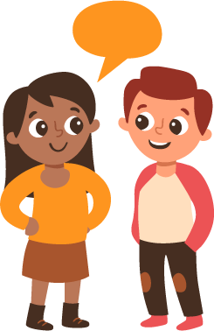


Pair Share
Have you ever heard the word "upstander" before?
Do you have any ideas about what it might mean?
lausd.org/human-relations

Slide 4


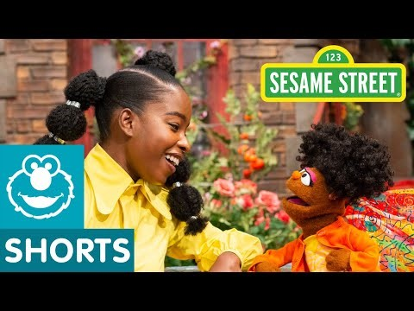
Becoming An Upstander
lausd.org/human-relations
Notes:
https://www.youtube.com/watch?v=vzpnitSjZA4

Slide 5
What Is An Upstander?
You always have a choice.
As an upstander, you are choosing to:
Stand up for what you believe
Stand up for others
Speak up when you see things that are unfair
Support someone who is being mistreated
lausd.org/human-relations

Slide 6
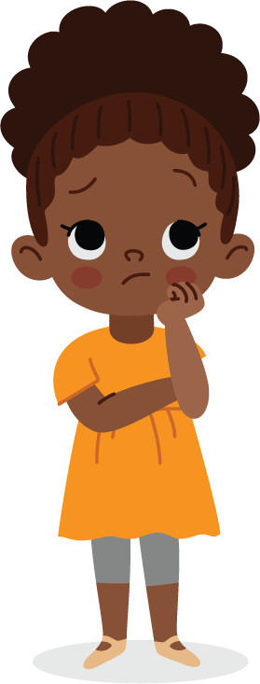
Pair Share
Have you ever made a choice to be an upstander?
What can you share about that?
lausd.org/human-relations

Slide 7
Make A Choice To Be An Upstander
It can be hard to make a choice to be an upstander if you have never had an practice.
Today we are going to practice some things you can say to be an upstander.
lausd.org/human-relations

Slide 8
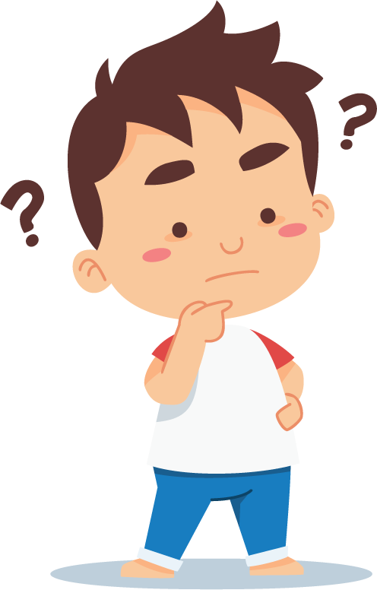
An Unkind Classmate
You hear a classmate say that they think someone else is a bad friend.
Here are some ways you can respond:
That's not nice
We shouldn't talk about other people
Nobody is perfect
Mind your own business
lausd.org/human-relations

Slide 9
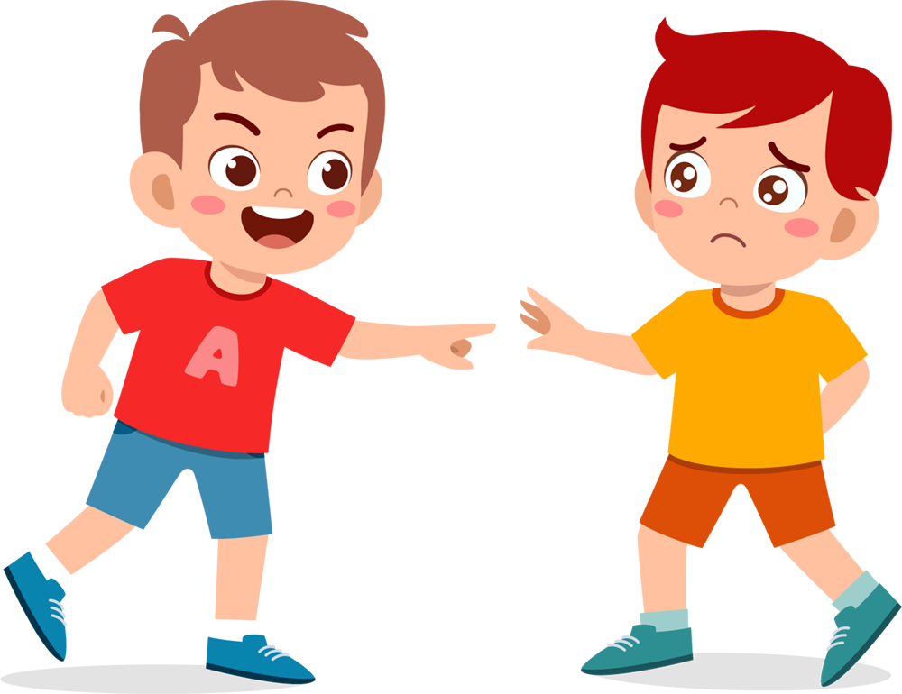
A Mean Friend
Your friend tells you they don't want to play with you because you won't share your chips.
Here are some ways you can respond:
Real friends don't make me do things I don't want to do
I don't have to be friends with people who
treat me like that
There are lots of people who I can play with
who will treat me nice
lausd.org/human-relations

Slide 10
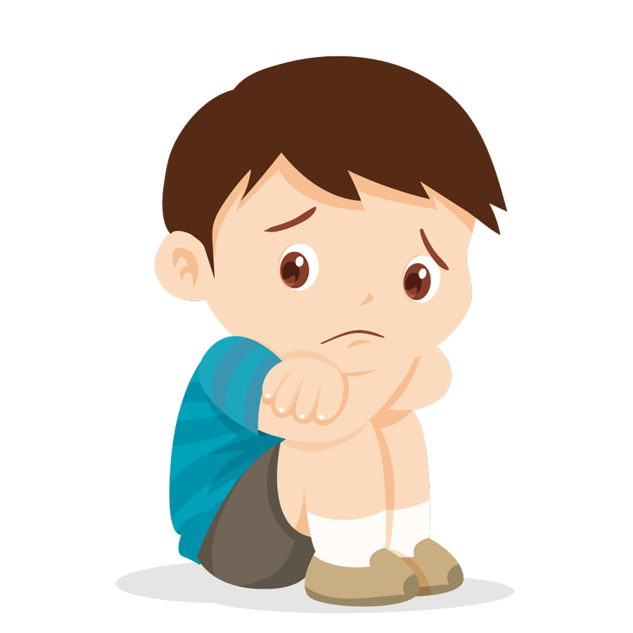
A Hurt Student
Here are some ways you can respond:
I saw what just happened, are you ok?
That wasn't cool how they talked to you.
Do you want me to go with you to get a drink of water?
You see one student yelling at another student on the playground, and the other student starts to cry.
lausd.org/human-relations

Slide 11
Pair Share
There are lots of ways you can be an upstander by standing up for yourself and others.
What might you say?
lausd.org/human-relations
lausd.org/human-relations

Slide 12
Remember - You Can Only Control You
Respect others’ choices- try not to take it personally if they don’t react or respond as you would expect.
You make your choices, they make theirs.
But you can make a choice to try to empower others!
You are not responsible for the final outcome of a situation.
lausd.org/human-relations

Slide 13
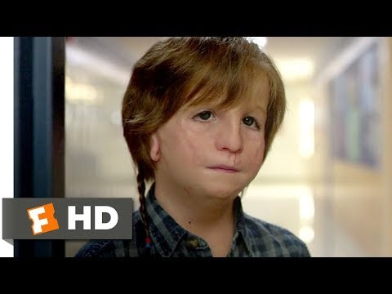
Becoming An Upstander
lausd.org/human-relations
Notes:
https://www.youtube.com/watch?v=ceWNY5eNSWY

Slide 14
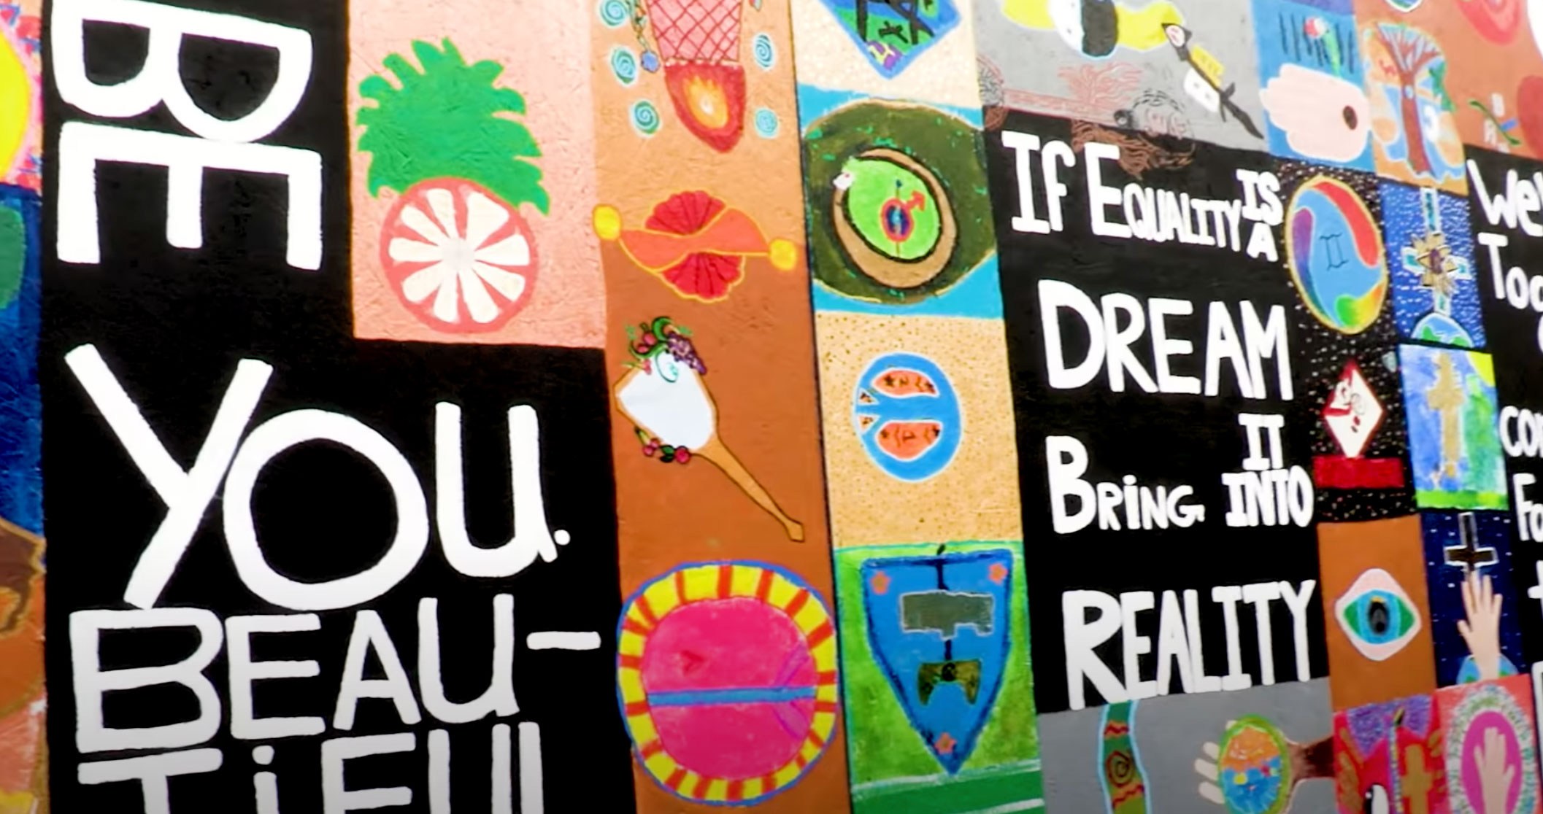
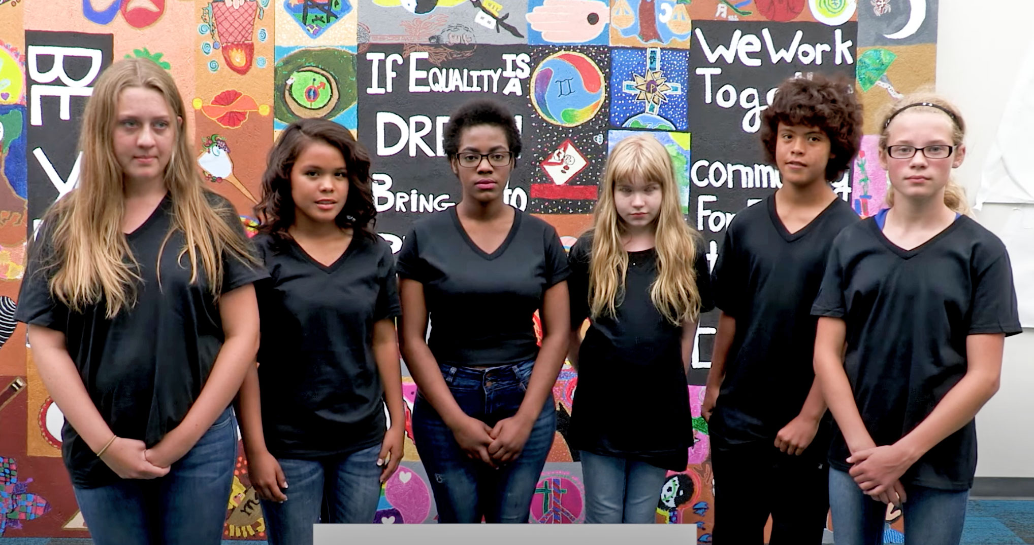
Pair Share
What examples did you see in that clip of someone being an upstander?
lausd.org/human-relations

Slide 15
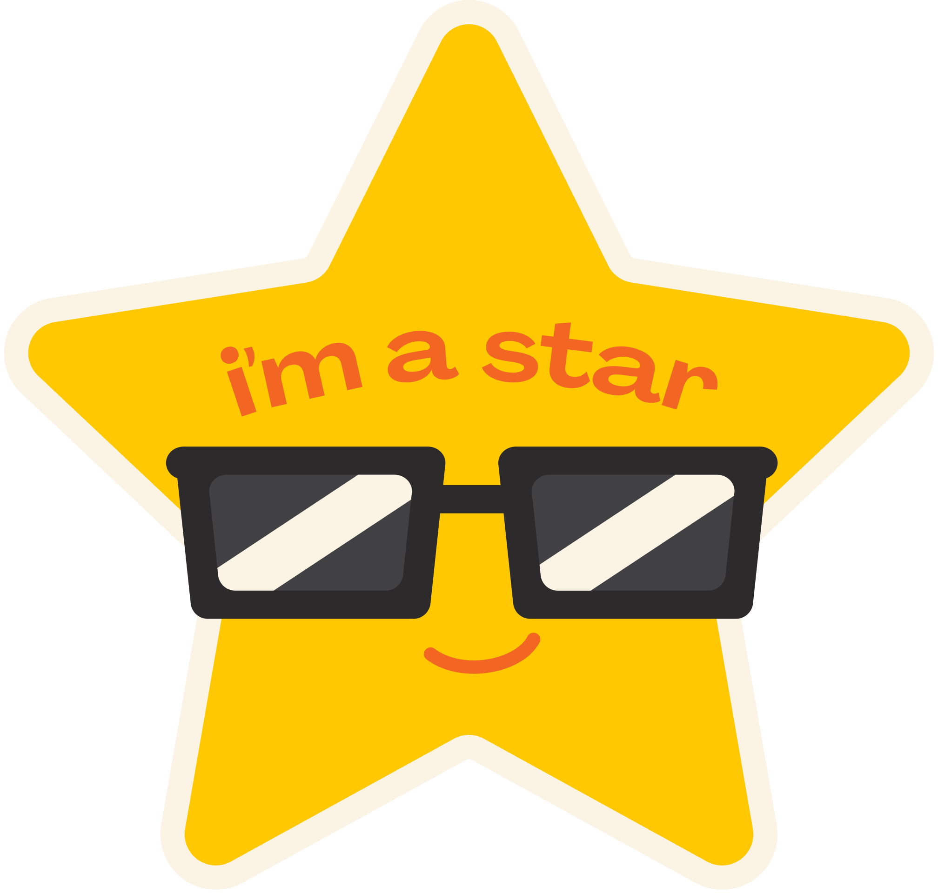
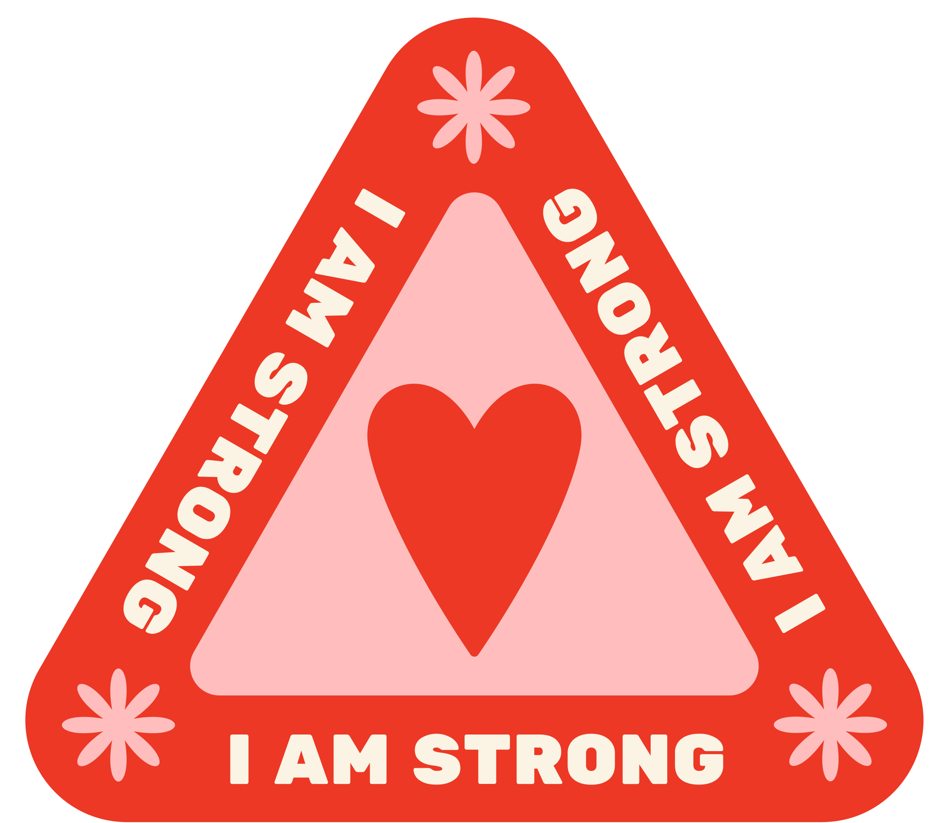
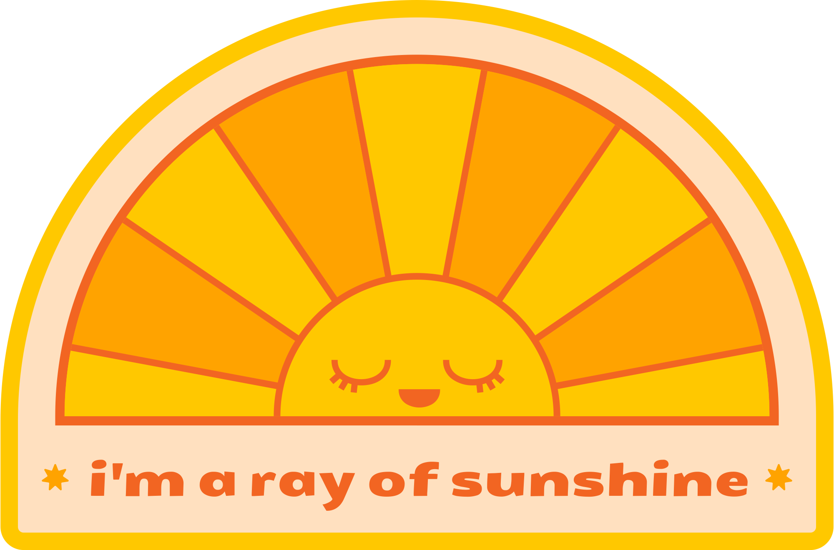
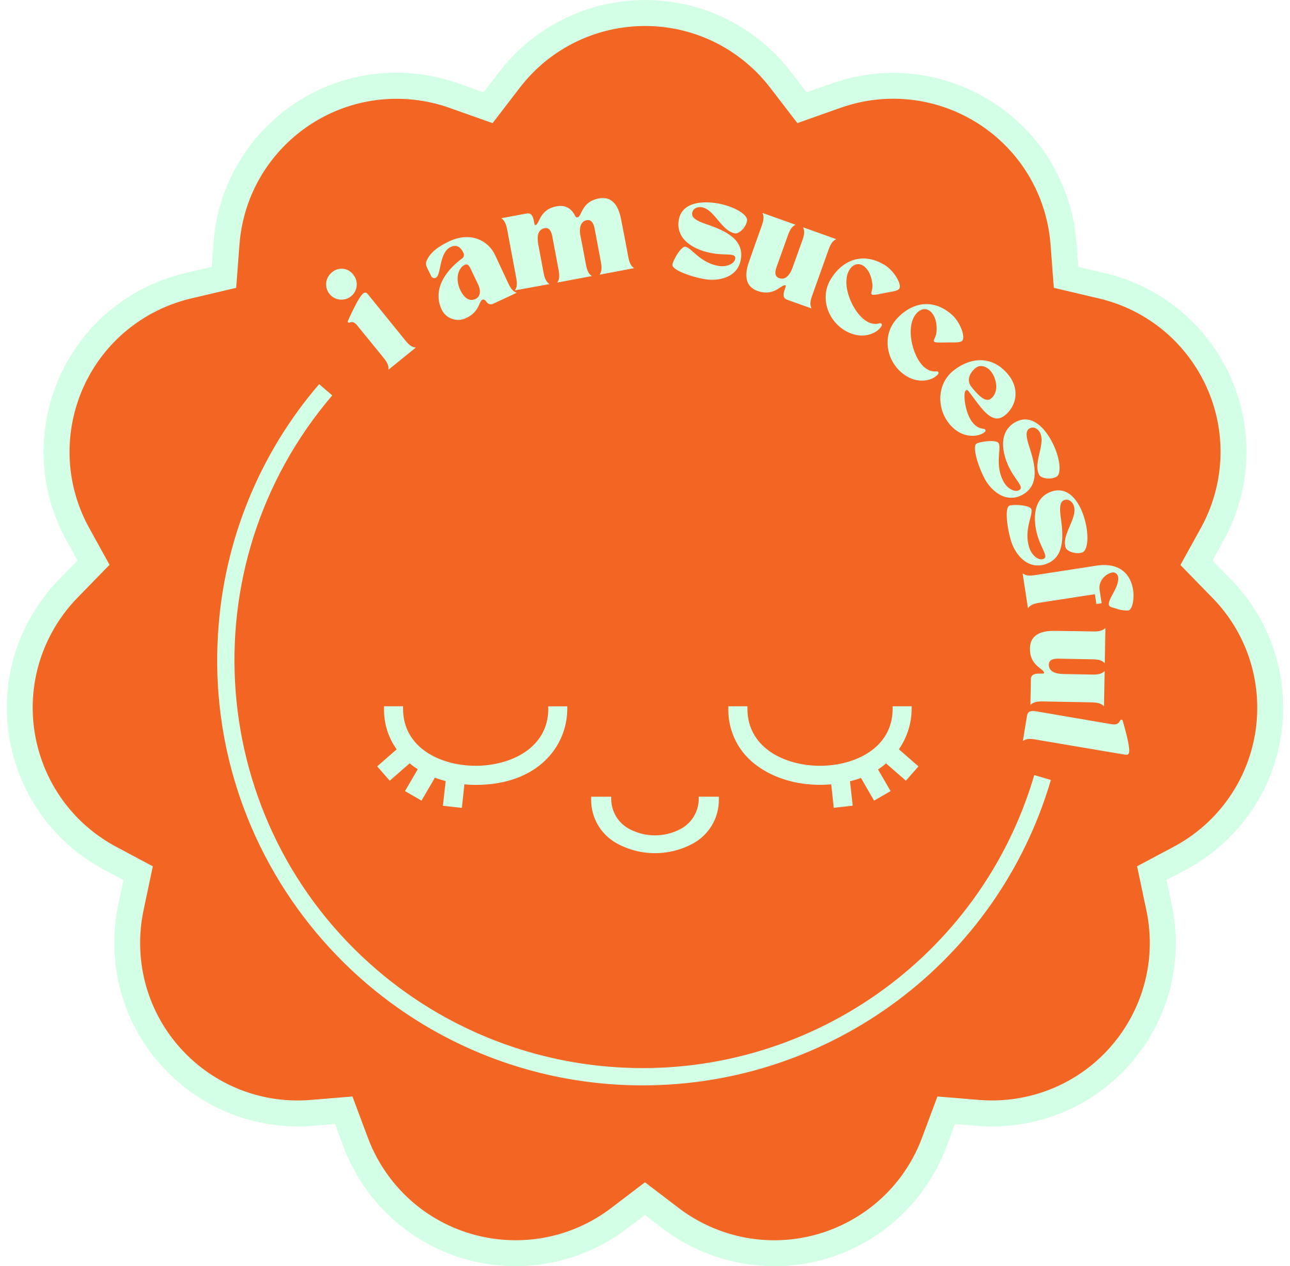
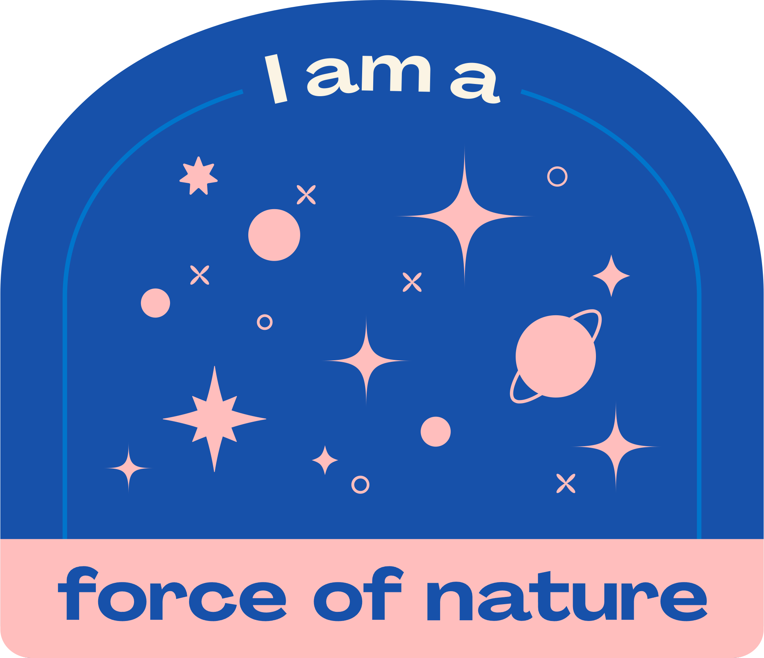

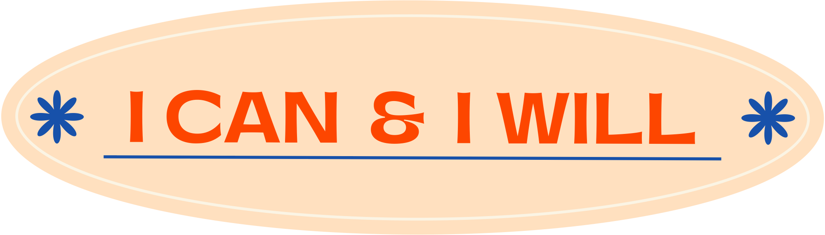
Check Out
What will you do for yourself today?
lausd.org/human-relations

Slide 16
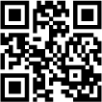
Committed to fostering a safe and respectful District, school and community culture where the seeds of peace and justice are down so that all students and staff can lead safe, purposeful and academically fruitful lives.
Connect with us at bit.ly/LAUSD-HRDE
lausd.org/human-relations

